Slide 1


Data Science Roadmap
Your journey to becoming a data scientist.
by Ameerah Kareem

Slide 2

What is Data Science?
Turning data into actionable insights.
Data Exploration
Modeling
Uncovering hidden patterns.
Building predictive models.
Communication
Sharing findings with others.

Slide 3
Essential Skills for Data Scientists
Technical and soft skills are crucial.
Technical Skills
Soft Skills
Programming languages
Communication and storytelling
Statistics and mathematics
Problem-solving and critical thinking
Machine learning algorithms
Collaboration and teamwork
Data visualization tools
Continuous learning and adaptability

Slide 4

Data Collection and Preprocessing
Gather, clean, and transform data.
1
Data Acquisition
Collect data from various sources.
2
Data Cleaning
Handle missing values, outliers, and inconsistencies.
3
Data Transformation
Normalize, scale, and encode data.

Slide 5
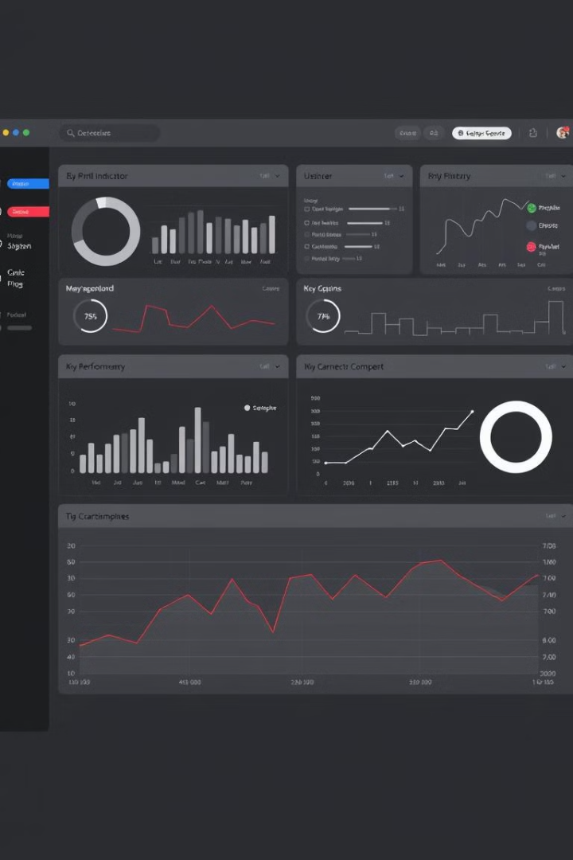
Exploratory Data Analysis
Discover insights and patterns.
1
Univariate Analysis
2
Bivariate Analysis
Explore single variables.
Explore relationships between pairs of variables.
3
Multivariate Analysis
Explore relationships between multiple variables.

Slide 6
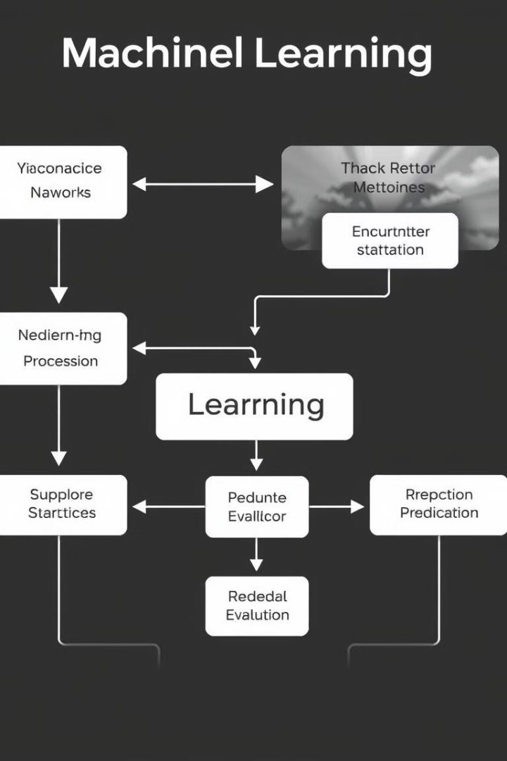



Machine Learning Algorithms
Develop predictive models.
Supervised Learning
Training models on labeled data.
Unsupervised Learning
Discovering patterns in unlabeled data.
Reinforcement Learning
Training agents to learn through interactions.

Slide 7
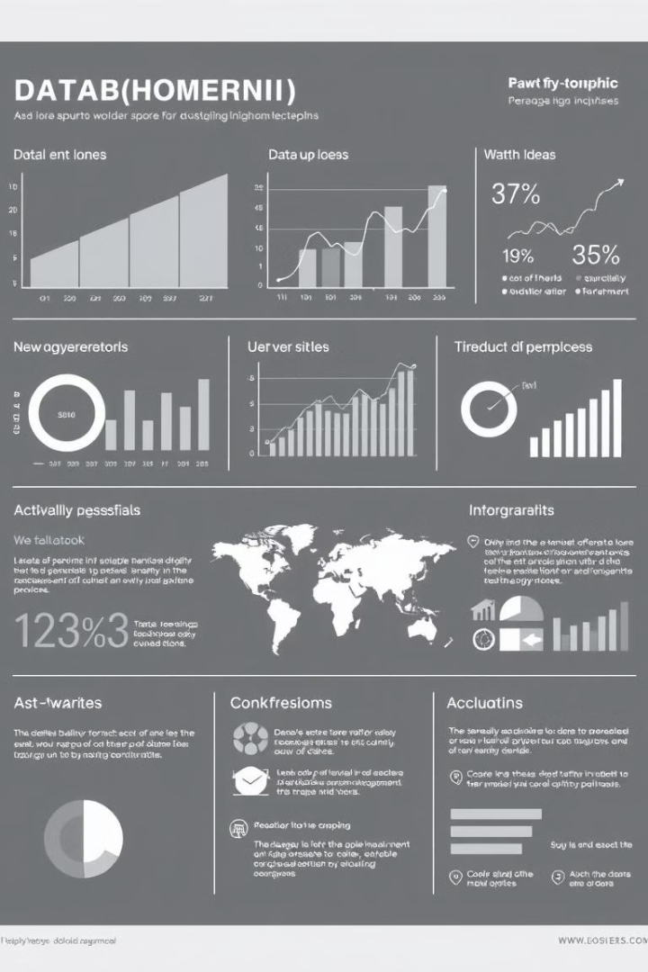



Data Visualization and Storytelling
Communicate findings effectively.
Charts and Graphs
Visualize data trends and patterns.
Maps
Show geographical distributions.
Presentations
Communicate insights to stakeholders.

Slide 8
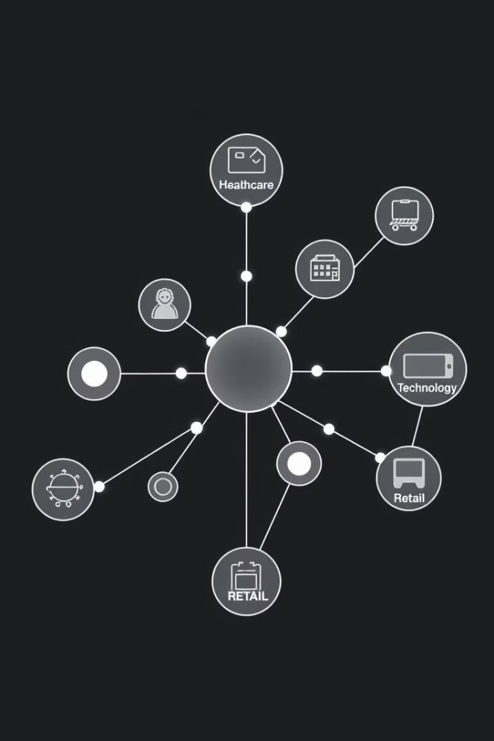
Real-World Applications of Data Science
Improving decision-making across various industries.
Healthcare
Disease prediction and diagnostics
Finance
Fraud detection and risk assessment
Retail
Personalized recommendations and customer insights
Technology
Image recognition and natural language processing

